Slide 1

Electric-vehicles visualization
Dashboard about electric cars

Slide 2
Team has worked on proj
Abdelazim abdelmonem abdelazim
Mohamed Ehab Abdallah
Kareem Ahmed Shabana

Slide 3
Introduction
This projects talks about electric cars and its more effecint and more weather saver than the other cars using gasoline and so on.
In this project we will compare betwee the models of cars with its make and how many range they travel on
Also how many cars are Eligible and how many not so that Eligable ones are more frequently used , because they are more energy saver and more efficient
We had to add a lot of measures and columns to meet the requrments of the presentation so that we can we answer the questions we had on this data

Slide 4

Continue
In this dataset we used a lot of KPI’s about electric vehicles
DOL vehicle ID: this is unique ID and has no duplicates in dataset so that we will use it always to get the correct count of ditinct vehicles
CAFV: this stands for a program that gives rewards to certain clean energy vehicles like if its electric or hybrid
And it has 2 categories eligible and not eligible , so that eligible that vehicles are meeting the req of CAFV .
MSRP : stands for Manufacturer’s Suggested Retail Price. It is the price that the vehicle manufacturer recommends a dealer charge for the vehicle before any taxes, fees, or additional costs are added

Slide 5
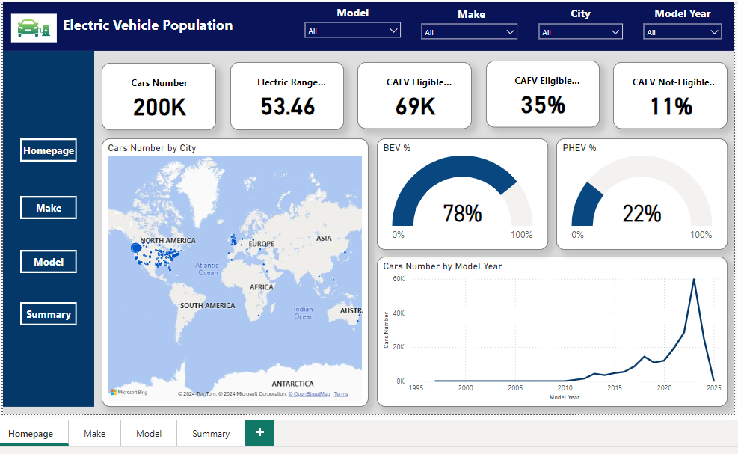
Overview

Slide 6
First part of the dashboard shows the Title and the slicers we used in the all 3 pages of the dashboard (Make , City , Model Year and Model).
Second part on the left show the pages navigotaion so that makes the customer teleports from pages easily in this case they are 4 pages (HomePage , Make Page , Model Page, Summary Page ).
And in the middle part contains cards and charts that’s shows the visulizations that shows the data we need to show .
HomePage: shows the overview of the data and the basic cards and charts.
Make Page: shows the same cards but with different charts to show the relationship between company that made the electric cars and other parametrs that we are comabring to
Model Page: shows the same cards but with different charts to show the relationship between model of each company of electric cars and other parametrs that we are comabring to
Summary: the conclusion of all the dashboard combined in one Page

Slide 7
Home-Page

Slide 8
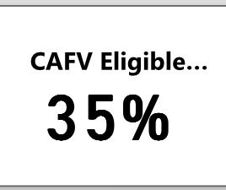
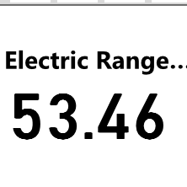

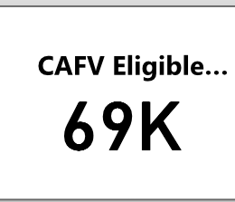
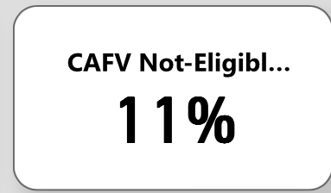
Cards
This page shows 5 card
Total number of cars in the dataset (without duplicates).
Distance of every car that have traveled .
Shows how many cars that took the eligibility certificate.
Shows the percent of how many cars are eligible.
Shows the percent of cars that are not eligible.

Slide 9
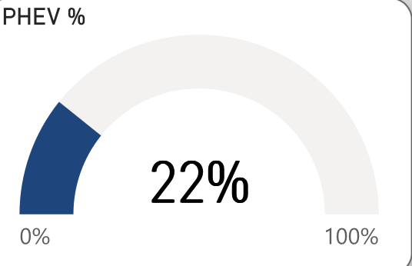
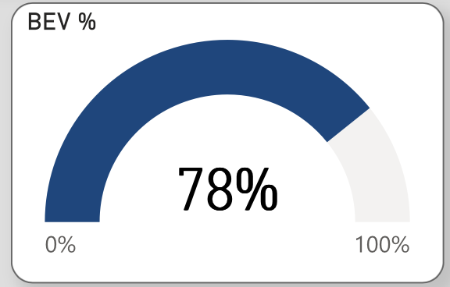
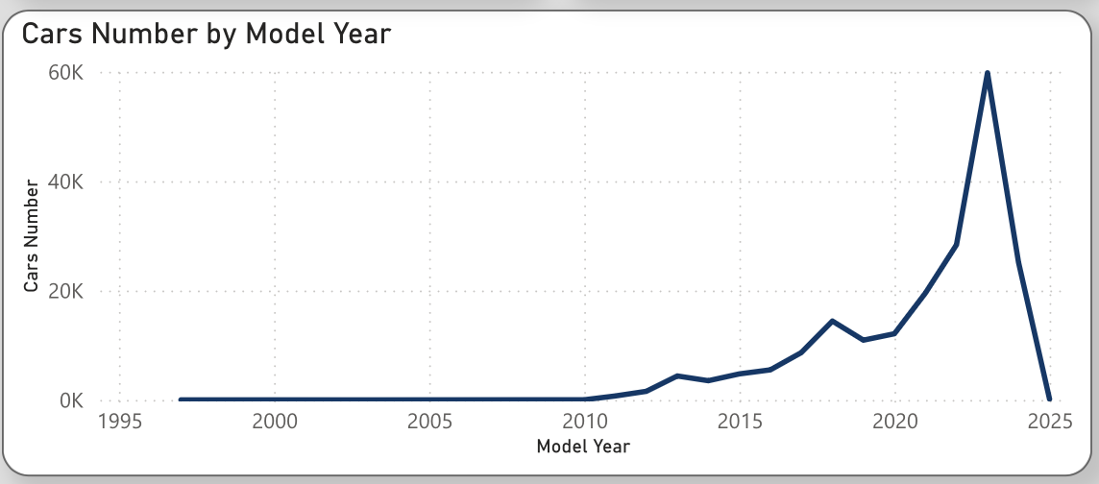
Charts
This Page has 4 charts
The percent of BEV cars (cars that only debends on electricty ”only”)
The percent of PHEV (cars that debends on both electricty and gas)
Map that shows how many cars in every country
How many cars are made in every year

Slide 10
Make-Page (Company name)

Slide 11
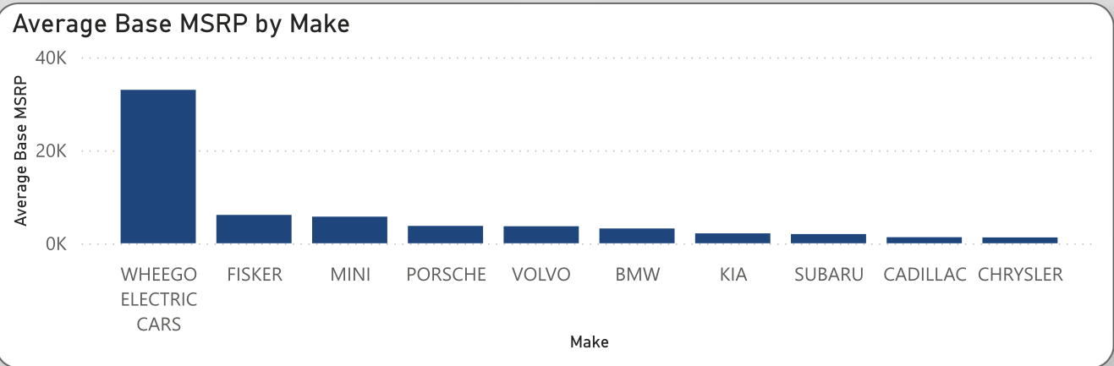
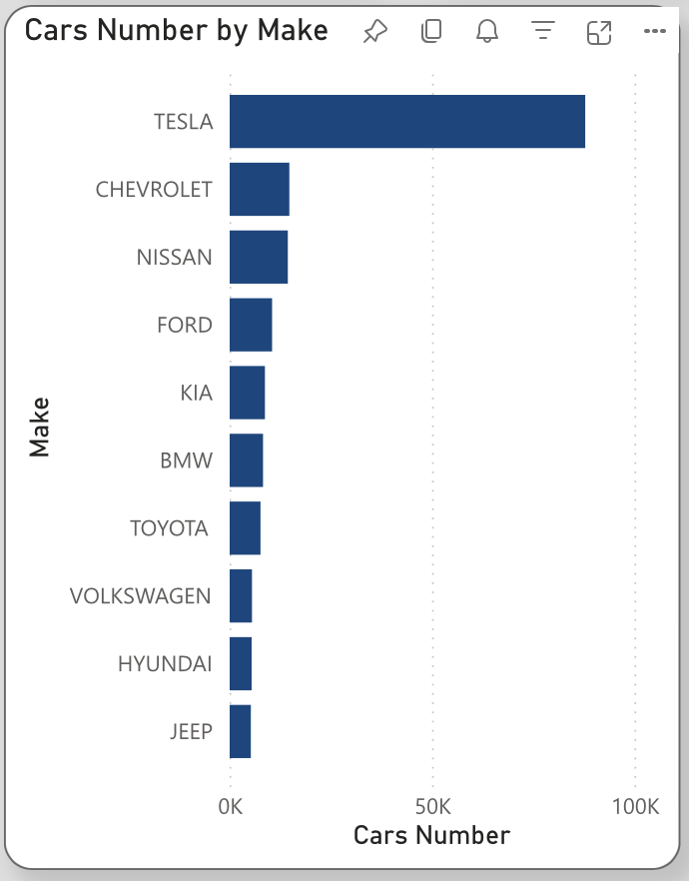
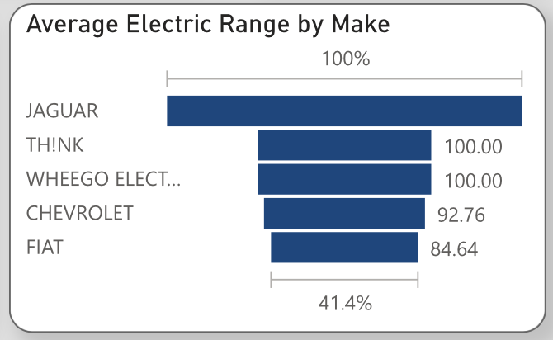
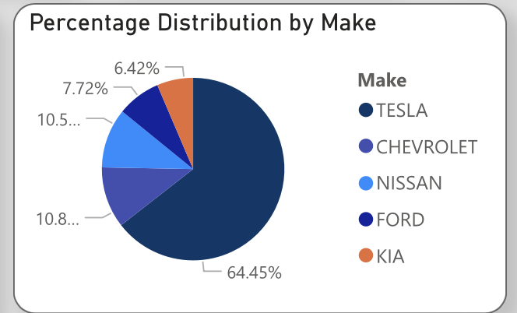
Charts
This page contains 4 charts
How many cars that every company made
Percetatge of every combany in the market of elecric cars
Average of ditance travlled of every car in each combany
The relation between manfacturer price and the company name

Slide 12
Model-Page(Model year)

Slide 13
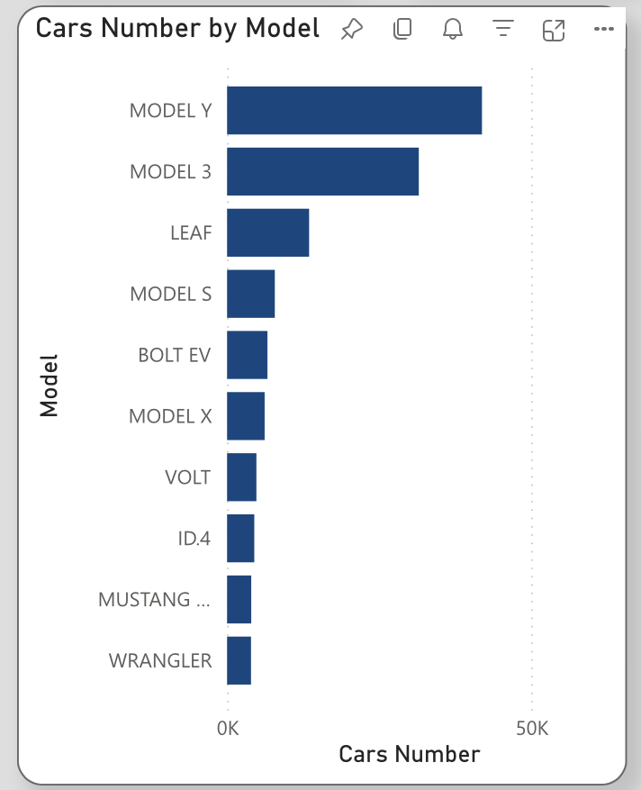
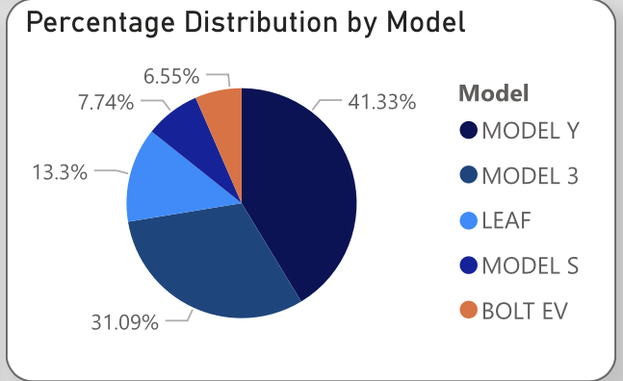
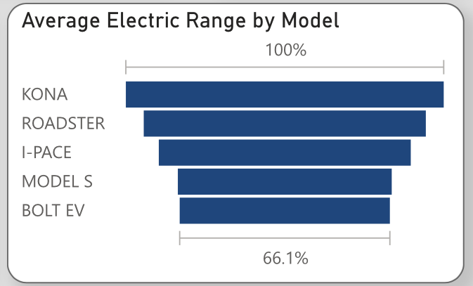
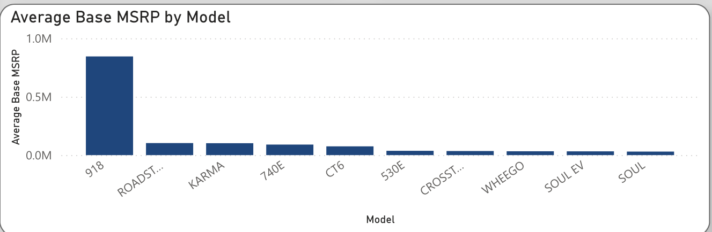
Charts
This page have the same charts as the Make page but in differnce parameter like we have changed Make to the Model and all is the same

Slide 14
Insights

Slide 15
Q&A
1- What is overall trend of electric vehicle registrations over the years?
Tesla is the trend car most of the years.
2- Which countries have the highest concentration of electric vehicles?
top 5 countries (King, snohomish, Pierce, Clark, Thurstone)
3- what is the percentatge of electric vehicles are eligible?
35% of electric vehicles are eligible (70000) cars
4- How does the electric range vary by make and model ?
from the dashboard we will find that the most cars bought is from Tesla but the average electric range is Jaguar
5-What the most car model have been bought?
Model Y from Tesla has bought (41893 cars)

Slide 16
Continue Q&A
6- What is the most car with electric range?
the most car model has cut distance is (Model 3) by Tesla.

Slide 17

Summary

Slide 18
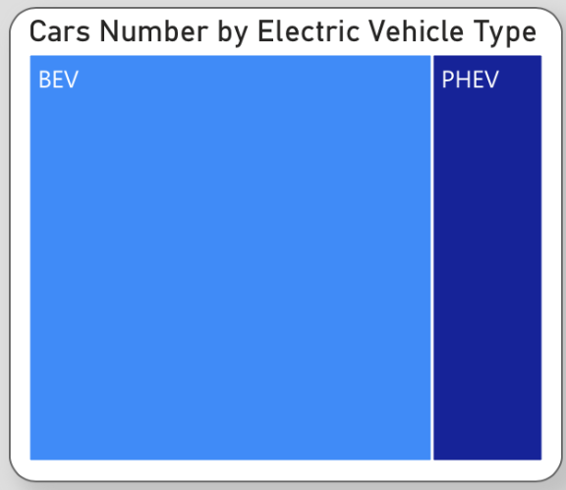
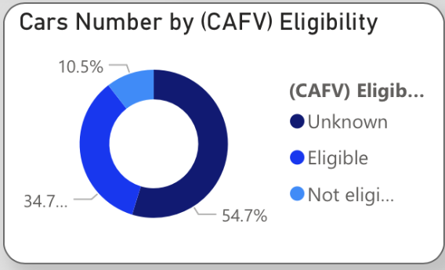
Charts
This page includes all the previuos charts combined in one table
With other 2 charts
How many cars are eligabile
How many cars are BEV and PHEV

Slide 19
